Slide 1
Town of Manchester, Connecticut June 30, 2024 Audit Presentation
February 4, 2025

Slide 3
Agenda:
Terms of the Engagement
Executive Summary
Financial Highlights
Federal and State Single Audit
Governance Communication
Upcoming GASB Pronouncements
Notes:
Our message to clients
We are who we are today because we listen closely to our clients. Those we serve want to be confident that when they need help — personally or professionally, today or in the future — we will bring relevant expertise. Therefore, we continuously advance a diverse team to deliver integrated capabilities across an ever-broadening spectrum of wealth advisory, outsourcing, and public accounting needs.
When asked what we do by prospects or friends, we say:
CLA escalates industry specialization to a new level. We believe that to serve you best, we must cultivate hyper-specialized industry professionals who understand not only your financial operations, but your entire organizational model and goals.
As the world changes, so do your opportunities and challenges. We constantly build our capabilities across our three integrated business lines so that when you have a need, we’re right next to you, ready to help.
As one of the nation’s leading professional service firms, CLA has never let up on our commitment to serve clients of all sizes and locations.
We have unparalleled expertise in serving private businesses and their owners. We believe that, over a lifetime, we can help them build wealth and create a lasting impact and legacy.
We align ourselves to leaders within nonprofits, health care organizations, governmental entities, financial institutions, and Fortune 1000 companies to help them advance their goals and realize their purpose.

Slide 4
Terms of the Engagement:
Express opinions on whether the basic financial statements are presented in accordance with GAAP
Express an “in relation” to opinion on the schedule of expenditures of federal awards and schedule of expenditures of state financial assistance.
Express an opinion on compliance related to major federal and state award programs
Provide a report on internal control over financial reporting and compliance with laws, regulations, contracts and grants
Provide a report on internal control over compliance related to major federal and state award programs
Notes:
Our message to clients
We are who we are today because we listen closely to our clients. Those we serve want to be confident that when they need help — personally or professionally, today or in the future — we will bring relevant expertise. Therefore, we continuously advance a diverse team to deliver integrated capabilities across an ever-broadening spectrum of wealth advisory, outsourcing, and public accounting needs.
When asked what we do by prospects or friends, we say:
CLA escalates industry specialization to a new level. We believe that to serve you best, we must cultivate hyper-specialized industry professionals who understand not only your financial operations, but your entire organizational model and goals.
As the world changes, so do your opportunities and challenges. We constantly build our capabilities across our three integrated business lines so that when you have a need, we’re right next to you, ready to help.
As one of the nation’s leading professional service firms, CLA has never let up on our commitment to serve clients of all sizes and locations.
We have unparalleled expertise in serving private businesses and their owners. We believe that, over a lifetime, we can help them build wealth and create a lasting impact and legacy.
We align ourselves to leaders within nonprofits, health care organizations, governmental entities, financial institutions, and Fortune 1000 companies to help them advance their goals and realize their purpose.

Slide 5
Executive Summary
Financial Statements
Unmodified opinion on the financial statements
No findings reported in report on internal control and compliance
Federal Single Audit
Unmodified opinion on the major federal programs
No compliance findings or significant deficiencies in internal control over compliance
State Single Audit
Unmodified opinion on the major state programs
No compliance findings or significant deficiencies in internal control over compliance

Slide 6
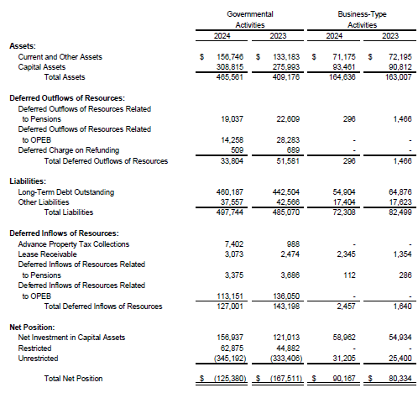
Financial Highlights
Government Wide Financial Statements

Slide 7
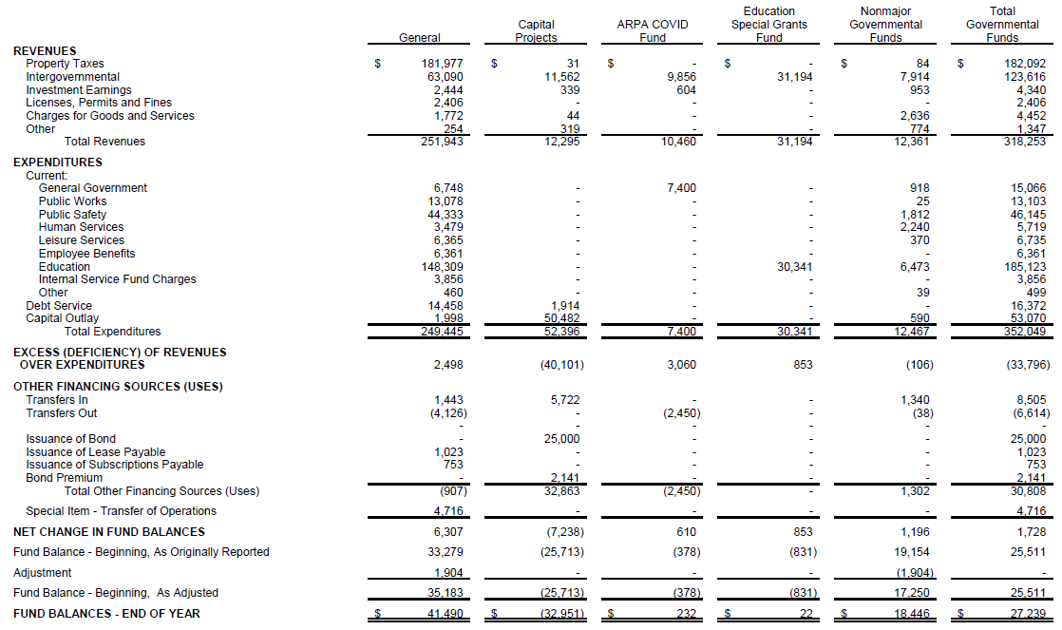
Financial Highlights – Governmental Funds

Slide 8
Financial Highlights
General Fund
Total Fund balance $41.5M
Nonspendable $35K – Prepaid Expenditures
Committed $1.8M – Education, $494K LOSAP benefits
Assigned – $9.2M
$756K Encumbrances
$2.75M Appeals
$2M Fire Apparatus
$1.2M Other
$2.5M – 2025 budget
Unassigned - $29.9M

Slide 9
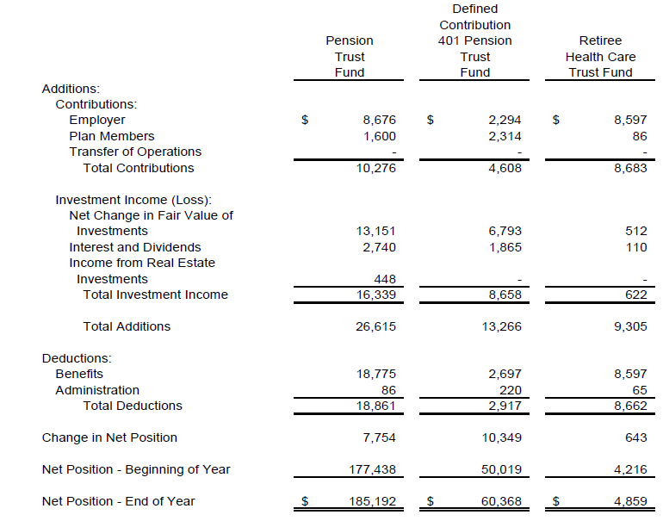
Financial Highlights
Pension and OPEB Trust Funds

Slide 10
Financial Highlights
Property Tax Collections – 98.00% compared to 98.42% in the prior year
Net Pension Liability – Town
$86.8M 68.09% funded
Net Pension Liability – CMERS
$25.7M 69.5% funded
Net OPEB Liability
$169.4M 2.79% funded
Total LOSAP Liability
408K Not funded

Slide 11
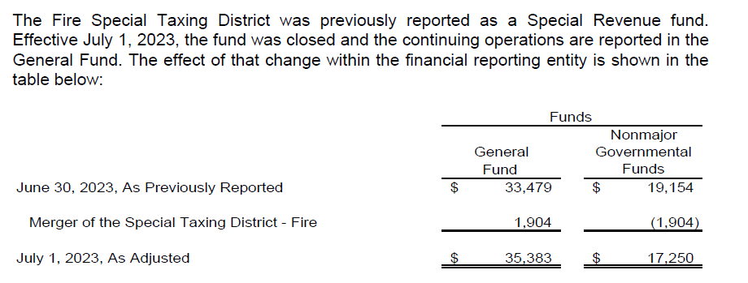
Merger of Special Taxing District

Slide 12
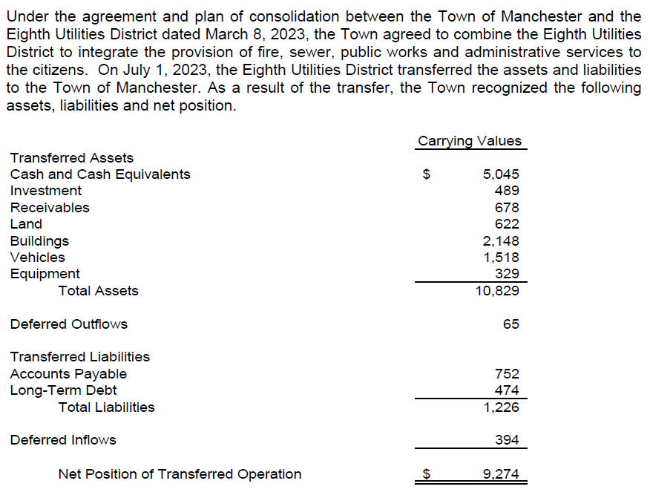
Transfer of Operations – Eighth Utilities District

Slide 13
Federal and State Single Audit
Overview

Slide 14
Federal Single Audit:
Total federal awards expended - $28.9M
Major programs
ARPA
Head Start
Capitalization Grants for Drinking Water State Revolving Funds
Unmodified opinion on major program compliance
No compliance or internal control findings
Notes:
Our message to clients
We are who we are today because we listen closely to our clients. Those we serve want to be confident that when they need help — personally or professionally, today or in the future — we will bring relevant expertise. Therefore, we continuously advance a diverse team to deliver integrated capabilities across an ever-broadening spectrum of wealth advisory, outsourcing, and public accounting needs.
When asked what we do by prospects or friends, we say:
CLA escalates industry specialization to a new level. We believe that to serve you best, we must cultivate hyper-specialized industry professionals who understand not only your financial operations, but your entire organizational model and goals.
As the world changes, so do your opportunities and challenges. We constantly build our capabilities across our three integrated business lines so that when you have a need, we’re right next to you, ready to help.
As one of the nation’s leading professional service firms, CLA has never let up on our commitment to serve clients of all sizes and locations.
We have unparalleled expertise in serving private businesses and their owners. We believe that, over a lifetime, we can help them build wealth and create a lasting impact and legacy.
We align ourselves to leaders within nonprofits, health care organizations, governmental entities, financial institutions, and Fortune 1000 companies to help them advance their goals and realize their purpose.

Slide 15
State Single Audit:
Total state awards expended - $69.3M
Major programs:
Alliance District
Adult Education
Priority School Districts
Town Aid Road
Consolidation of the Eighth Utilities District
Early Care and Education
Unmodified opinion on major program compliance
No compliance or internal control findings
Notes:
Our message to clients
We are who we are today because we listen closely to our clients. Those we serve want to be confident that when they need help — personally or professionally, today or in the future — we will bring relevant expertise. Therefore, we continuously advance a diverse team to deliver integrated capabilities across an ever-broadening spectrum of wealth advisory, outsourcing, and public accounting needs.
When asked what we do by prospects or friends, we say:
CLA escalates industry specialization to a new level. We believe that to serve you best, we must cultivate hyper-specialized industry professionals who understand not only your financial operations, but your entire organizational model and goals.
As the world changes, so do your opportunities and challenges. We constantly build our capabilities across our three integrated business lines so that when you have a need, we’re right next to you, ready to help.
As one of the nation’s leading professional service firms, CLA has never let up on our commitment to serve clients of all sizes and locations.
We have unparalleled expertise in serving private businesses and their owners. We believe that, over a lifetime, we can help them build wealth and create a lasting impact and legacy.
We align ourselves to leaders within nonprofits, health care organizations, governmental entities, financial institutions, and Fortune 1000 companies to help them advance their goals and realize their purpose.

Slide 16
Governance Communication
Summary

Slide 17
Governance Communication:
No new standards required to be adopted during the current year
Significant Estimates
Net Pension, OPEB Liability
Alternative Investments – Net Asset Value valuation
Claims Incurred but not Reported
No disagreements with management
Management did not consult with other accountants
Significant Unusual Transactions
Merger of Fire District
Transfer of Operations - Eighth Utilities District
Notes:
Our message to clients
We are who we are today because we listen closely to our clients. Those we serve want to be confident that when they need help — personally or professionally, today or in the future — we will bring relevant expertise. Therefore, we continuously advance a diverse team to deliver integrated capabilities across an ever-broadening spectrum of wealth advisory, outsourcing, and public accounting needs.
When asked what we do by prospects or friends, we say:
CLA escalates industry specialization to a new level. We believe that to serve you best, we must cultivate hyper-specialized industry professionals who understand not only your financial operations, but your entire organizational model and goals.
As the world changes, so do your opportunities and challenges. We constantly build our capabilities across our three integrated business lines so that when you have a need, we’re right next to you, ready to help.
As one of the nation’s leading professional service firms, CLA has never let up on our commitment to serve clients of all sizes and locations.
We have unparalleled expertise in serving private businesses and their owners. We believe that, over a lifetime, we can help them build wealth and create a lasting impact and legacy.
We align ourselves to leaders within nonprofits, health care organizations, governmental entities, financial institutions, and Fortune 1000 companies to help them advance their goals and realize their purpose.

Slide 18
Governance Communication con’t:
No difficulties encountered in performing the audit
Uncorrected misstatements –
allocating of the MSIP “profit” to enterprise funds
unrecorded CHEFA loan
No material adjusting journal entries
No independence issues
Notes:
Our message to clients
We are who we are today because we listen closely to our clients. Those we serve want to be confident that when they need help — personally or professionally, today or in the future — we will bring relevant expertise. Therefore, we continuously advance a diverse team to deliver integrated capabilities across an ever-broadening spectrum of wealth advisory, outsourcing, and public accounting needs.
When asked what we do by prospects or friends, we say:
CLA escalates industry specialization to a new level. We believe that to serve you best, we must cultivate hyper-specialized industry professionals who understand not only your financial operations, but your entire organizational model and goals.
As the world changes, so do your opportunities and challenges. We constantly build our capabilities across our three integrated business lines so that when you have a need, we’re right next to you, ready to help.
As one of the nation’s leading professional service firms, CLA has never let up on our commitment to serve clients of all sizes and locations.
We have unparalleled expertise in serving private businesses and their owners. We believe that, over a lifetime, we can help them build wealth and create a lasting impact and legacy.
We align ourselves to leaders within nonprofits, health care organizations, governmental entities, financial institutions, and Fortune 1000 companies to help them advance their goals and realize their purpose.

Slide 19
Upcoming GASB Pronouncements
Summary

Slide 20
GASB Standards:
Implementation Year 2025
Statement 101 – Compensated Absences
Statement 102 – Certain Risk Disclosures
Implementation Year 2026
Statement 103 – Financial Reporting Model Improvements
Statement 104 – Disclosure of Certain Capital Assets
Notes:
Our message to clients
We are who we are today because we listen closely to our clients. Those we serve want to be confident that when they need help — personally or professionally, today or in the future — we will bring relevant expertise. Therefore, we continuously advance a diverse team to deliver integrated capabilities across an ever-broadening spectrum of wealth advisory, outsourcing, and public accounting needs.
When asked what we do by prospects or friends, we say:
CLA escalates industry specialization to a new level. We believe that to serve you best, we must cultivate hyper-specialized industry professionals who understand not only your financial operations, but your entire organizational model and goals.
As the world changes, so do your opportunities and challenges. We constantly build our capabilities across our three integrated business lines so that when you have a need, we’re right next to you, ready to help.
As one of the nation’s leading professional service firms, CLA has never let up on our commitment to serve clients of all sizes and locations.
We have unparalleled expertise in serving private businesses and their owners. We believe that, over a lifetime, we can help them build wealth and create a lasting impact and legacy.
We align ourselves to leaders within nonprofits, health care organizations, governmental entities, financial institutions, and Fortune 1000 companies to help them advance their goals and realize their purpose.

Slide 21
Questions?

