Slide 1
Personal Property Declaration Information Session
2023

Slide 2
Agenda
01 | Presentation
02 | Filing Walkthrough
03 | Office Hour

Slide 3
Table of Contents
Slides 4-8 | Introduction to Personal Property
Slides 9-11 | ABC’s to Filing Declarations
Slides 12-22 | Codes
Slides 23-42 | How to File: A Step-By-Step Guide
Slides 43-49 | FAQ & Additional Information
 | Q & A

Slide 4
01
INTRO TO PERSONAL PROPERTY

Slide 5
WHAT IS A BUSINESS?

Slide 6
Definition of a Business
Business is the practice of making one's living or making money by producing or buying and selling products. It is also "any activity or enterprise entered into for profit."
Please see handout titled What is a Business? Am I in business? Am I a business?

Slide 7
WHAT IS PERSONAL PROPERTY?

Slide 8
WHAT IS PERSONAL PROPERTY?
INCLUDES:
Furniture (computers, office chairs, desks)
Unregistered motor vehicles
Signs
Vending Machines
Leasehold Improvements
Tools
Machinery
Any other equipment used in a business or to earn income.
EXCLUDES:
Real Estate
Anything permanently affixed to the land
CT STATE STATUTES:
Section 12-71
Section 12-41
Section 12-43

Slide 9
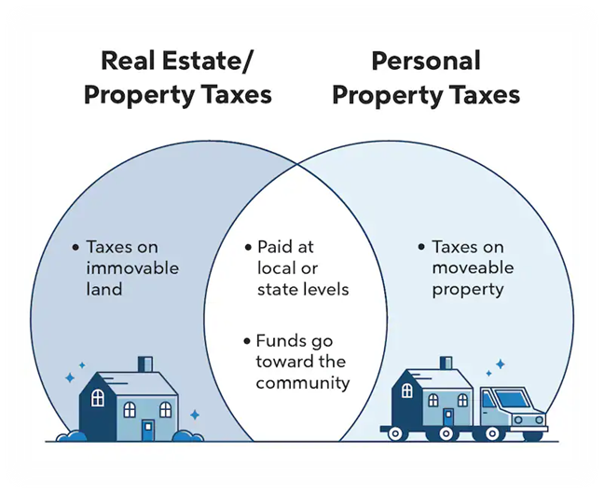
How Do We Assess Personal Property?
What is the assessment year?
October 1, 2023 – September 30, 2024
Capitalization Threshold
The total value of an asset a company uses to depreciate over several years opposed to an expense in a single year
How do we get the assessment?
We add all up the depreciated values of all declared business assets.

Slide 10
02
ABC’S TO FILING DECLARATIONS

Slide 11
Declaration Information
Due Date: November 1st
Must be filed annually
If the declaration is not filed OR filed after
the deadline you will receive a 25% penalty
on your assessment
If you do not submit a declaration, the Assessors
office will have to complete it for you.
YOU DO NOT WANT THIS TO HAPPEN!

Slide 12
The ABC’s
01
02
03
Submit Early
No Longer in Business?
To ensure you do not receive a 25% penalty on your assessment, it is best practice to fully complete your declaration and submit it rather than wait until the November 1st due date.
If you believe you have received a declaration in error. DO NOT IGNORE IT! Please send us a letter detailing out why you think there was an error.
Failure to return the declaration with the explanation will result in the 25% penalty on your assessment
Submit Complete Forms
An incorrect or incomplete form will be returned to the business for proper correction and completion.
Resubmit the form prior to November 1st or you will receive a 25% penalty

Slide 13
03
PERSONAL PROPERTY CODES

Slide 14
Code #10
Machinery & Equipment
Industrial manufacturing machinery & equipment
CGS 12-81 (76) – Code #13: Not eligible for an exemption
Examples:
Tools
Dies
Jigs
Patterns

Slide 15
Code #13
Manufacturing Machinery & Equipment
CGS 12-81 (76) – Eligible for Exemption
Manufacturing machinery & equipment used in research or engineering devoted to manufacturing; or used for the significant servicing or overhauling of industrial machinery or factory products.

Slide 16
Code #17
Farm Machinery
Farm machinery used in the operation of a farm.
Examples:
Tractors
Harrows
Bush Hogs
Hay Bines
Hay Rakes
Hay Balers
Dozers
Back Hoes
Hydroponic Farm Equipment
Aquaculture Equipment
Corn Choppers
Milking Machines
Milk Tanks
Coolers
Chuck Wagons

Slide 17
Code #18
Farming Tools
Examples:
Hoes
Rakes
Pitch Forks
Shovels
Hoses
Brooms

Slide 18
Code #19
Mechanic Tools
Examples
Wrenches
Air Hammers
Jack Sockets

Slide 19
Code #9
Unregistered Motor Vehicles
Examples
Campers
RV’s
Snowmobiles
Trailers
Trucks
Off Road Construction
Vehicles
Passenger Cars
Tractors
INCLUDES any car registered in another state but garaged in CT.

Slide 20
Code #16
Furniture, Fixtures, and Equipment
Furniture, fixtures, and equipment all of commercial, industrial, manufacturing, mercantile, trading, and all other businesses, occupations, and professions.
Examples
Calculators
Copy Machines
Telephones
(including mobile phones)
Desks
Chairs
Tables
File Cabinets
Answering Machines
Postage Meters
Cash Registers
Movable Air
Conditioners
Partitions
Display Racks
Refrigerators
Freezers & Other
Kitchen Equipment

Slide 21
Code #20
Electronic Data Processing Equipment
Examples
Computers
Printers
Peripheral Computer Equipment
Any other computer based equipment acting as a computer as defined under Section 168 of the IRS Code of 1986
Bundled software IS taxable and must be included
Notes:
Bundled Software: software that is sold together with hardware, other software, or services at a single price.

Slide 22
Code #24
All Other Goods, Chattels & Effects
Any other taxable personal property not previously mentioned or which does not appear to fit into any of the other categories.
Examples
Video Tapes
Vending Machines
Pinball Games
Video Games
Signs
Billboards
Coffee Makers
Water Coolers
Leasehold Improvements (other than realty)

Slide 23
Code #23
Average Supplies
The average monthly quantity of supplies normally consumed in the course of business.
This code does not need to be broken down by year – it is a monthly/yearly total
Examples:
Stationary
Post-It Notes
Toner
Computer Paper
Pens
Pencils
Rulers
Staplers
Paper Clips
Medical and Dental Supplies
Maintenance Supplies

Slide 24
Code Examples

Slide 25
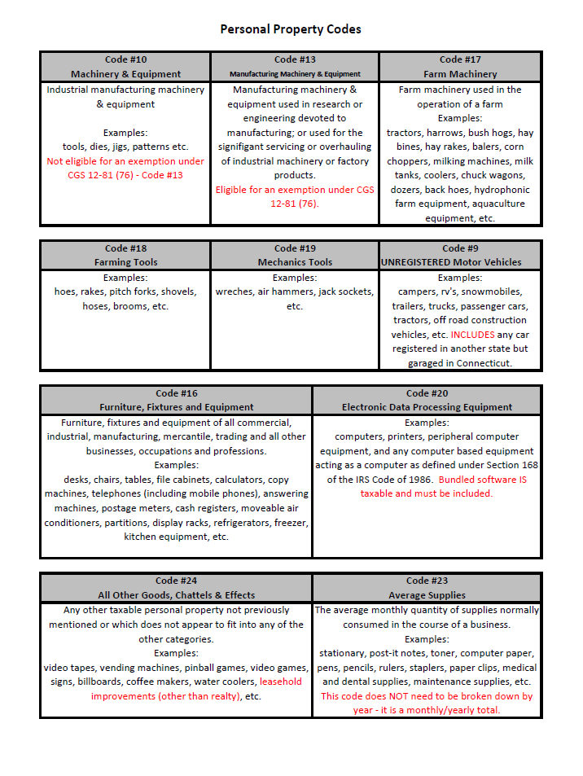
Code Form
On our website, we offer a code form to keep your assets organized. It is helpful for when you dispose of an asset and for future declarations.
If you would like to use this tool, you can print one from our website, under miscellaneous forms, look for Asset Worksheet

Slide 26
04
STEP-BY-STEP GUIDE TO FILING

Slide 27
LONG FORM DECLARATIONS

Slide 28
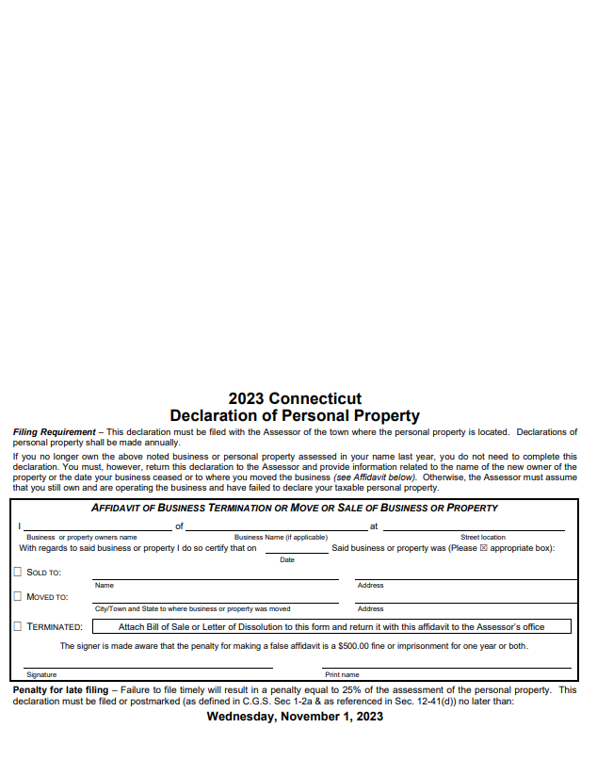
LONG FORM DECLARATION FILING
This is what the form looks like when you receive it in the mail.
In the top right hand corner it will show the Unique ID of the business, the name of the business, and the address.

Slide 29
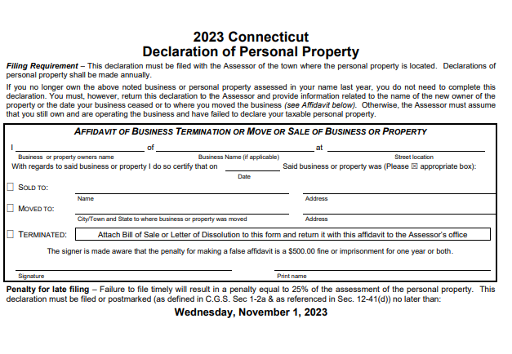
PAGE 1
Dissolution Information
This section is ONLY filled out when the business has been moved, sold, or terminated.
Until our office gets this information, your account will stay open and liable to taxation.
If your business has been terminated, DO NOT IGNORE THE FORM

Slide 30
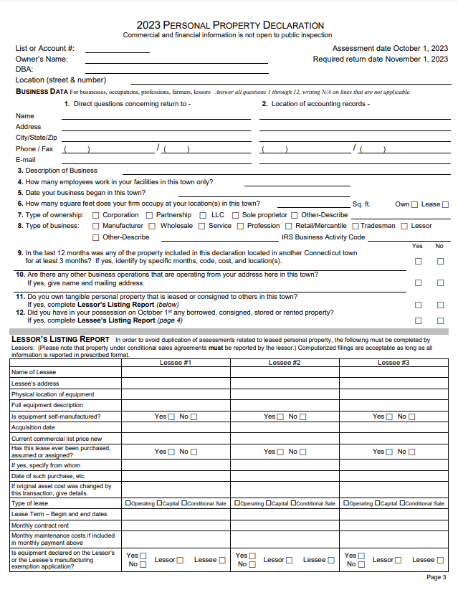
PAGE 3
Business Data:
Please answer all questions and fill in all spaces. If inapplicable please put N/A
Lessor’s Listing Report:
This area is completed only if you have leased any property.
Please round to nearest dollar amount

Slide 31
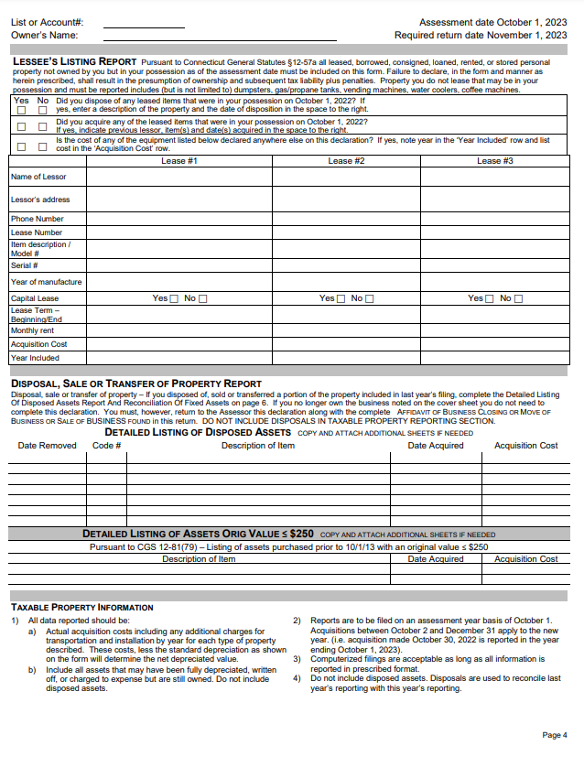
PAGE 4
Lessees Listing Report:
Complete if you have any leased, consigned, loaned, stored, or rented equipment in your possession.
Disposal, Sale, or Transfer of Property Report:
If you have disposed of any asset from October 2nd 2022 to October 1st 2023
NOTE: When filling out Acquisition Cost, this is the purchase price.
Please round to nearest dollar amount

Slide 32
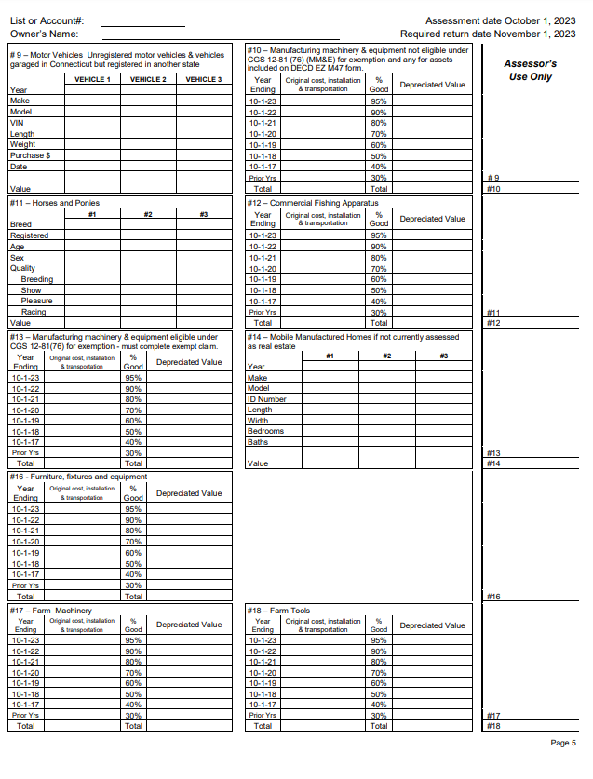
PAGE 5
Taxable Property Information:
This section is where you will fill out all of your owned assets organized by code.
NOTES:
This is where the Asset Worksheet handout comes in handy.
Make sure to total the depreciated values of each asset.
Make sure asset is filed by YEAR OF PURCHASE
Based of off the total which includes the sales tax
It is the TAXPAYERS responsibility to correctly depreciate their assets, NOT THE ASSESORS OFFICE
Please round to nearest dollar amount

Slide 33
PAGE 6
Reconciliation of Fixed Assets:
Fill in information to calculate the total assets declared this year October 1, 2023
Refer to Slide #9 for Capitalization Threshold explanation
Please round to nearest dollar amount

Slide 34
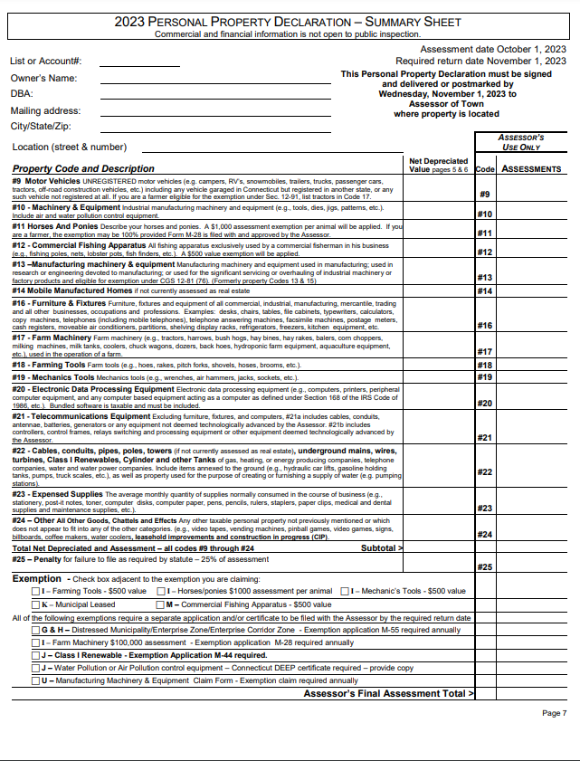
PAGE 7
Property Code & Description
From pages 5 & 6, use the TOTAL amounts of depreciated value and add all of the values together to get the total assessment
Please round to nearest tenth amount
Exemptions:
If you are claiming an exemption check the box next to the one that applies to you.
NOTE: Some exemptions require additional forms and documentation. Please see our office to get the correct documents.

Slide 35
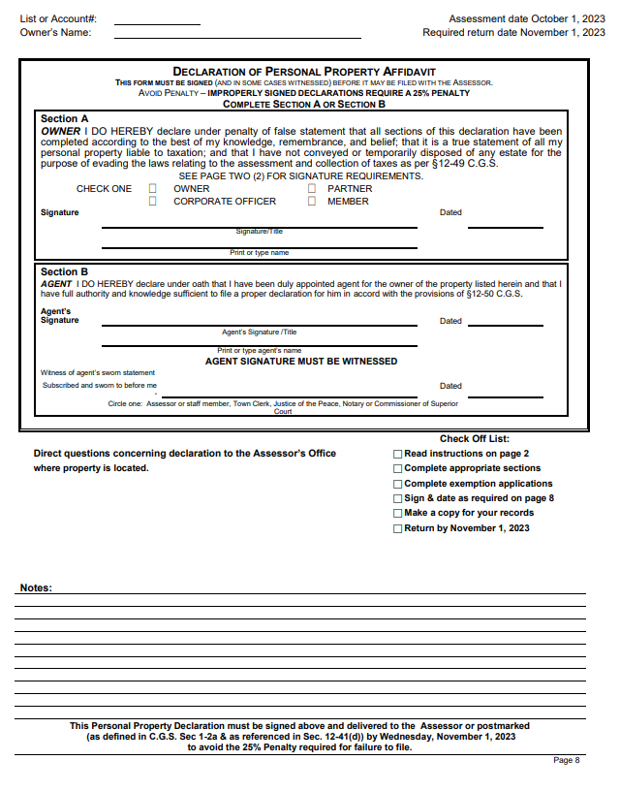
PAGE 8
Declaration of Personal Property Affidavit
Owners or those delegated to submitting the personal property declarations are required to fill out this section. If it is not, it will be returned for proper completion.
If it is not returned by November 1st it will receive a 25% penalty.
Note: There is a checklist and notes area. We encourage you to use it.

Slide 36
SHORT FORM DECLARATIONS

Slide 37
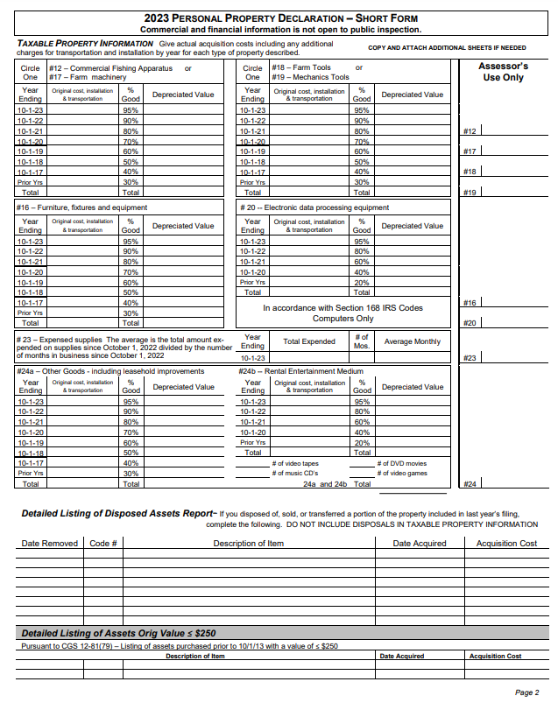
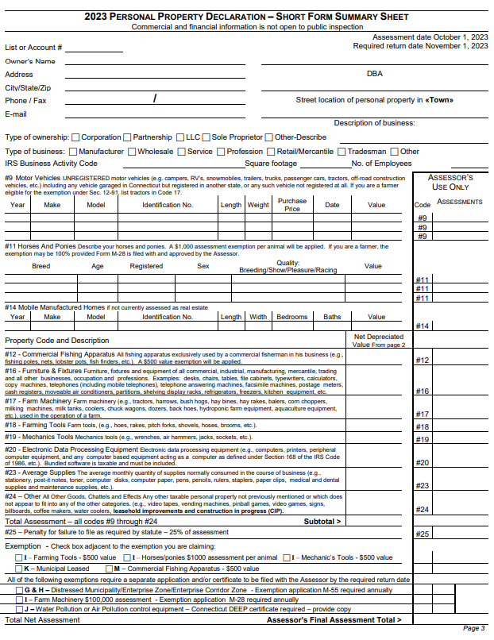
SHORT FORM
MOST BUSINESS WILL BE RECEIVING SHORT FORM DECLARATIONS
Codes 10 and 13 are not included on the short form declarations.
Code 24 is split into A (Other goods including leasehold improvements) and B (Rental entertainment medium)
Code 9 is only present on the summary sheet (page 3).
Lessors will receive the long form.

Slide 38
05
ADDITIONAL INFORMATION & Q&A

Slide 39
REQUESTING AN EXTENTON
CGS 12-42 &12-81K
The Assessor may grant a filing extension for good cause.
If an extension is needed you must request it in writing on or before November 1st (PA 19-200) in order for the request to be granted.
There is no appeal for extensions.

Slide 40
AUDIT
CGS 12-53
The Assessor is authorized to audit declarations, within 3 years of the date of the required filing. Substantial penalties are applicable if such an audit reveals property not declared as required by law.

Slide 41
APPEALS
CGS 12-111
These forms are available Feb 1st -20th and it must be filled out completely
The due date will appear on the form.
The Board of Assessment Appeals will appear in March and you will receive appointment information by email and/or mail.
Submit any documentation you wish for the Board to see when you return your form.
In April, you will receive a decision letter stating the change or no change.
Per CGS 12-117a, within 2 months of the mailing of your decisions you can file an appeal to the Supreme Court.

Slide 42
TO KNOW
Due Date: November 1st
Granted Extensions are due December 15th
If you do not file buy Nov 1, you will have a 25% penalty added to your assessment
If you do not file, the Assessor will have to estimate the assessment of the personal property assets along with adding the 25% penalty

Slide 43
TIPS & TRICKS
Do not write “no change” or “same as last year” on your form. This is considered incomplete and will be estimated and penalized 25%.
If you need assistance or clarification we are a phone call or email away.
If you have a separate Detailed Listing of Assets and Disposals Report please only submit one copy. If there are repeats it can be confusing.
If you claim your personal computer on your Federal Tax Return as a business asset, you need to put it on your declaration. This goes for all business assets.

Slide 44
Do you still have questions?
We can help you!
assessor@manchesterct.gov
(860) 647-3016
Assessors Office

